Slide 1


SEPTEMBER 26, 2026
2026 CNETS PATIENT CONFERENCE · OTTAWA
PRRT ADVANCEMENTS AND PITFALLS IN MANAGEMENT OF NEUROENDOCRINE
TUMORS (GEP-NETs)
Dr. Alda Aleksi, MD, MSc, FRCPC
Medical Oncologist · Theranostic Expert · Asst. Professor
University of Calgary · Arthur J.E. Child Comprehensive Cancer Centre · Calgary

Slide 2
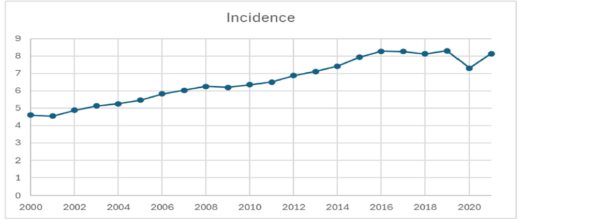
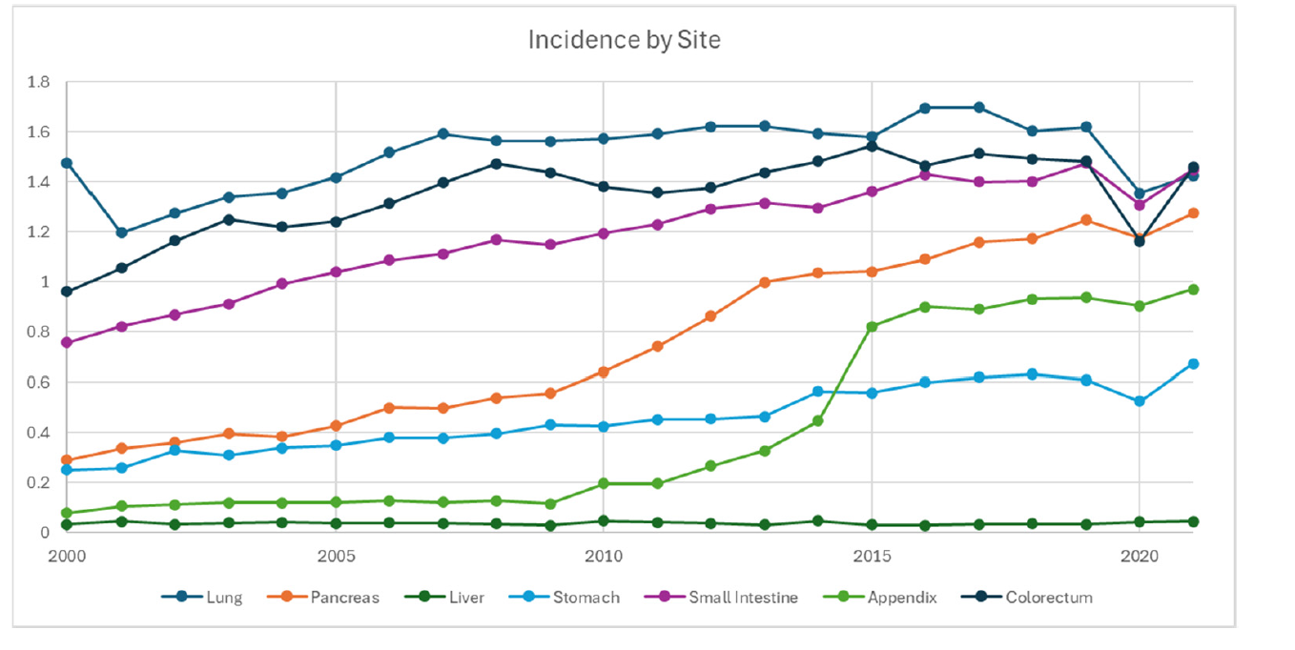
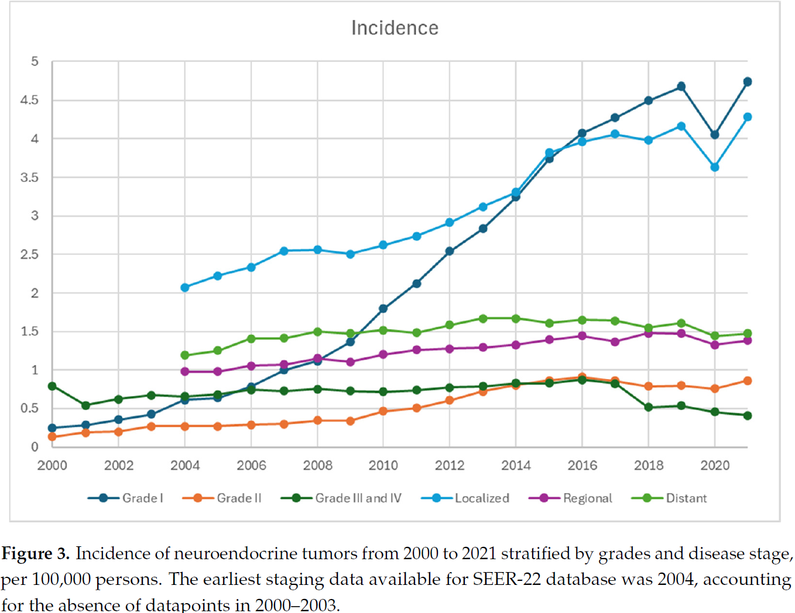
NET Incidence
Dethroning of NETs as Orphan/Rare Disease
US Incidence in 21st Century

Slide 3
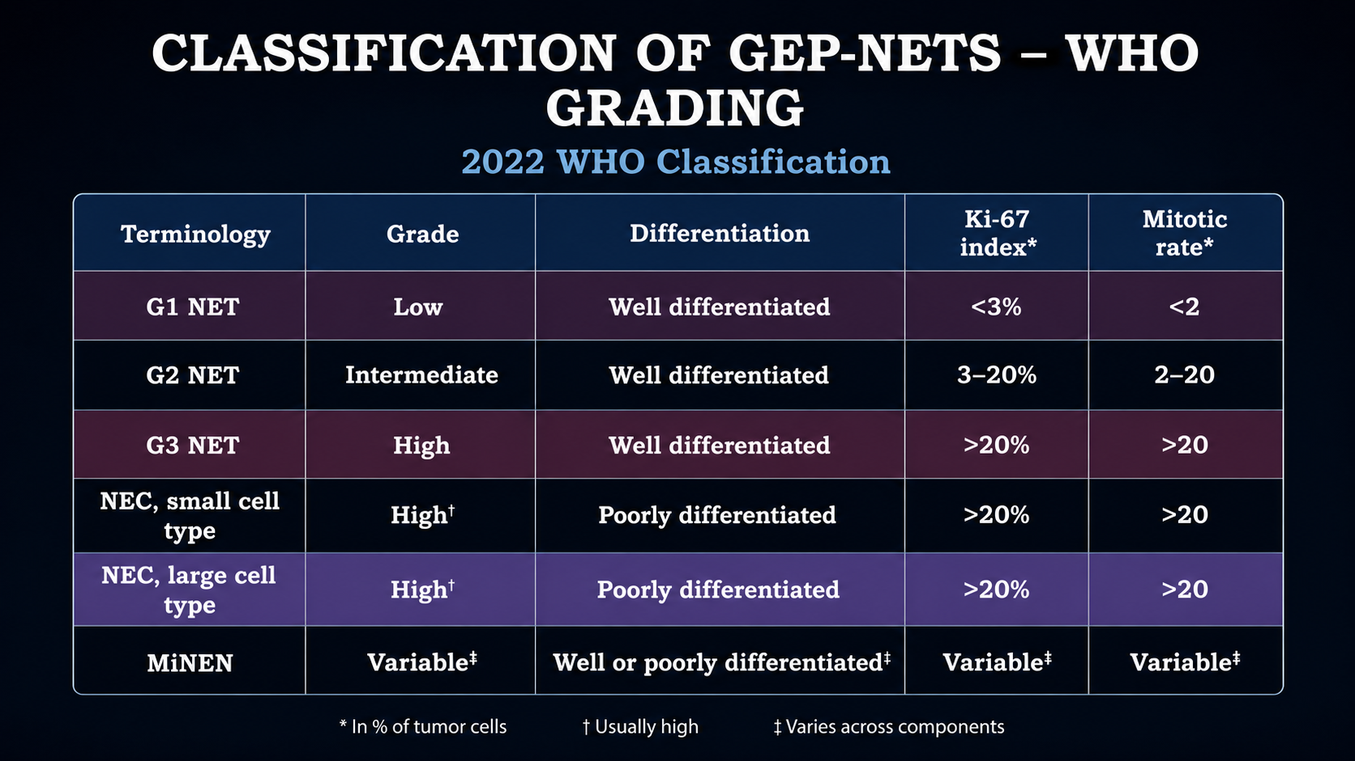

Slide 4
ESMO Clinical Practice Guidelines
Impact of new data on treatment algorithm
GEP-NENs
SI-NETs
Pan-NETs
NEC G3
NET G1/G2 SSTR-positive
Ki-67 <10% or slow growth
NET G2
Ki-67 >10–15% or rapid growth
SSTR-negative
NET G1
stable disease or slow growth
NET G2
NET G3
Ki-67 <50%
SSTR-negative
Cisplatin or carboplatin + etoposide
Ki-67 <10%
Watch & wait
SSA
EVE
Loco-regional therapy
SSA
STZ/5-FU
CAPTEM
EVE
SUN
CAPTEM
STZ/5-FU
STZ/5-FU
CAPTEM
EVE
SUN
FOLFIRI
FOLFOX
CAPTEM
+/- locoregional therapy
STZ/5-FU
CAPTEM
EVE
SUN
PRRT
EVE
EVE SUN
PRRT
PRRT
FOLFOX
TEM+/-CAP
IFN-alpha
PRRT
EVE
PRRT
EVE; SUN
Ann Oncol. 2020;31:844–60

Slide 5
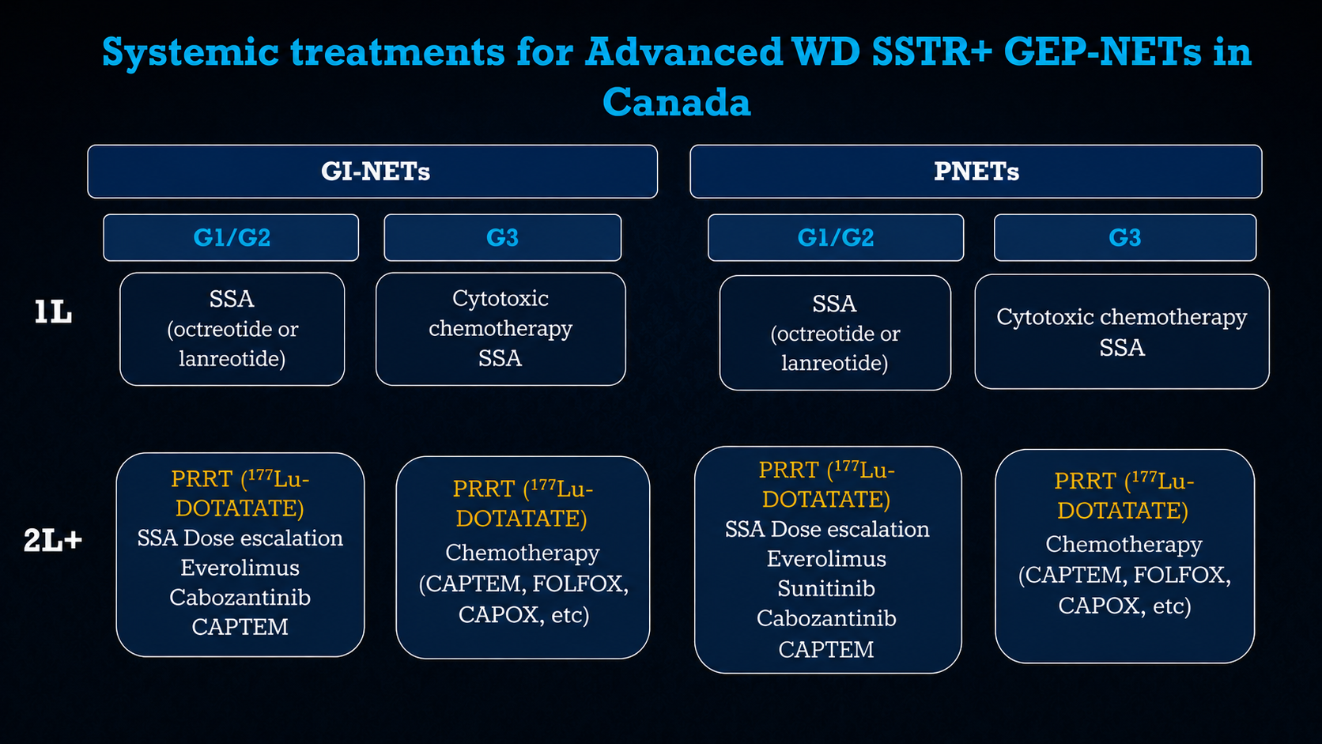

Slide 6
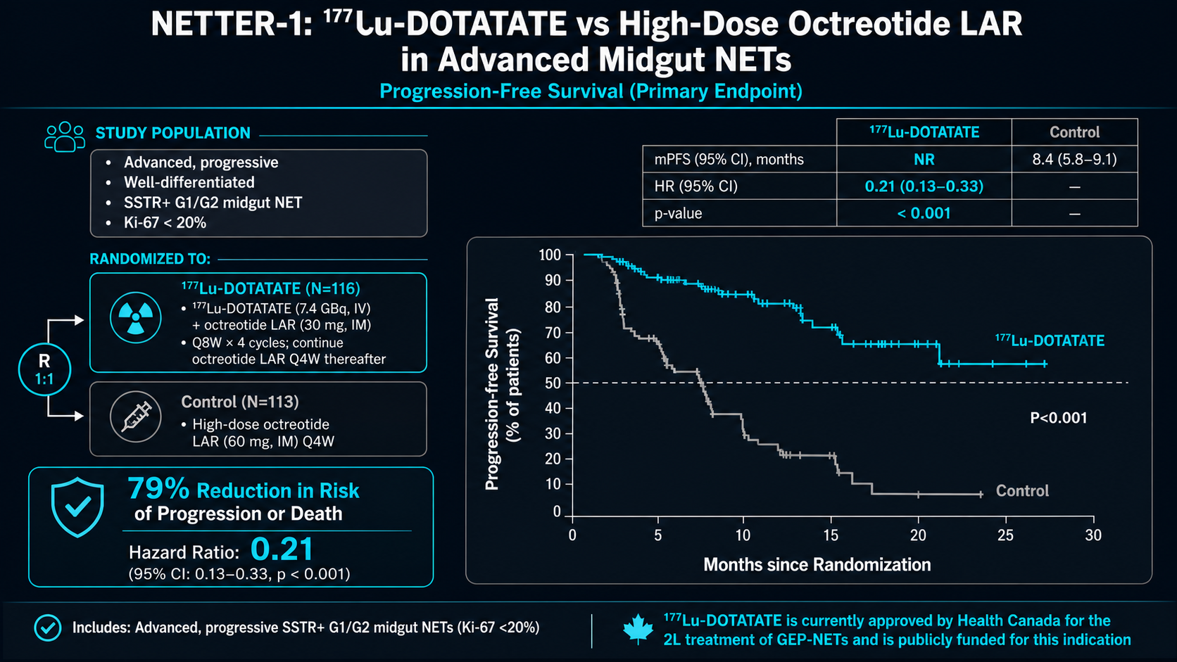

Slide 7
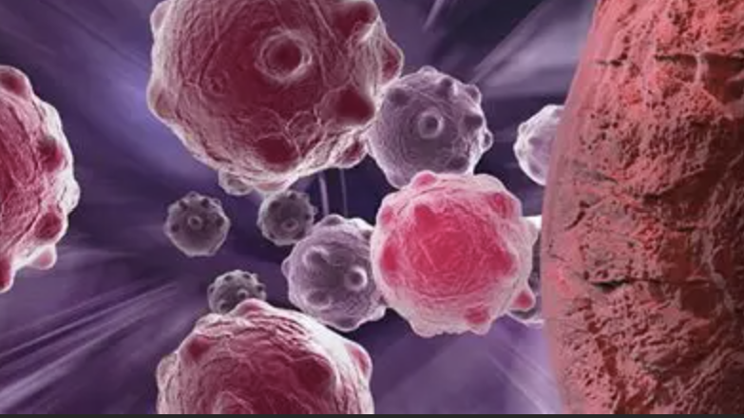
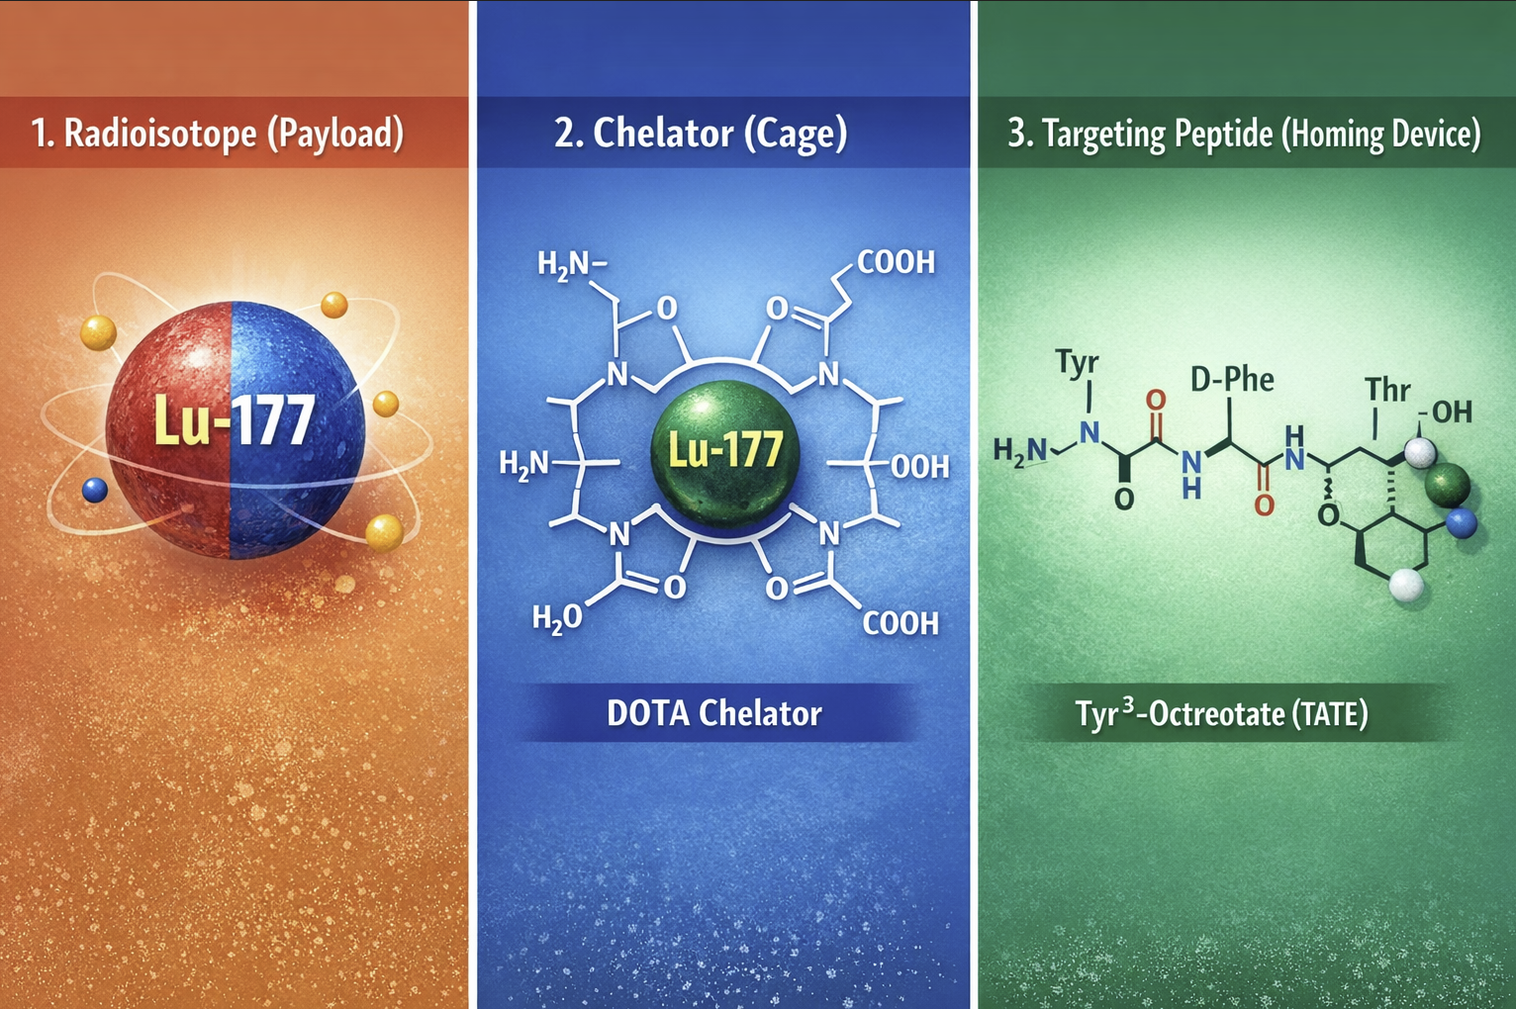
Lu-177 Dotatate Structure
1
(Lu-177)
Emits beta particles (therapy)
Emits gamma photons (imaging)
This is what kills tumor cells
2
DOTA-(Chelator (the “cage”)
(tetraazacyclododecanetetraacetic acid)
Macrocyclic ligand that tightly binds Lu-177, keeping it stable in the body
Prevents the metal from detaching and causing off-target toxicity
3
TATE- (Targeting peptide (the “homing device”) Tyr³-octreotate (TATE)
Somatostatin analog
Binds strongly to (SSTR2) on NET tumor cells
Directs the radioactive complex to tumor tissue
[Lu-177] — held by DOTA — attached to Octreotate → binds tumor → delivers radiation locally

Slide 8
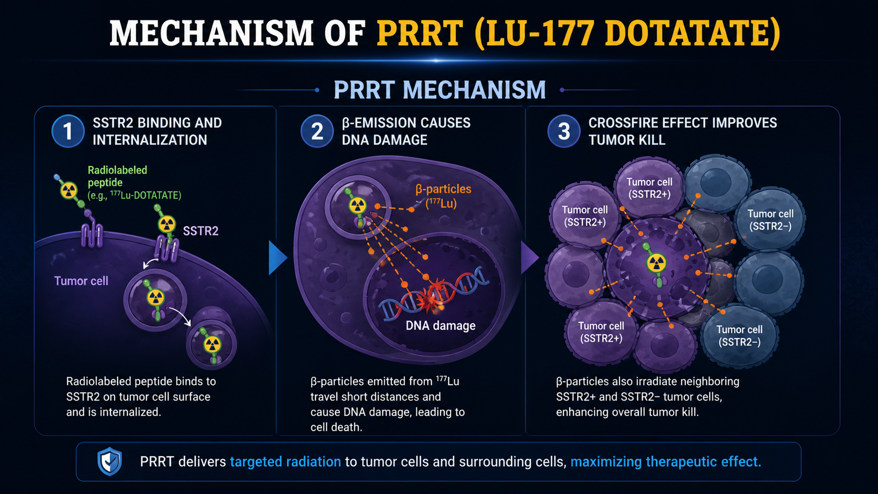

Slide 9
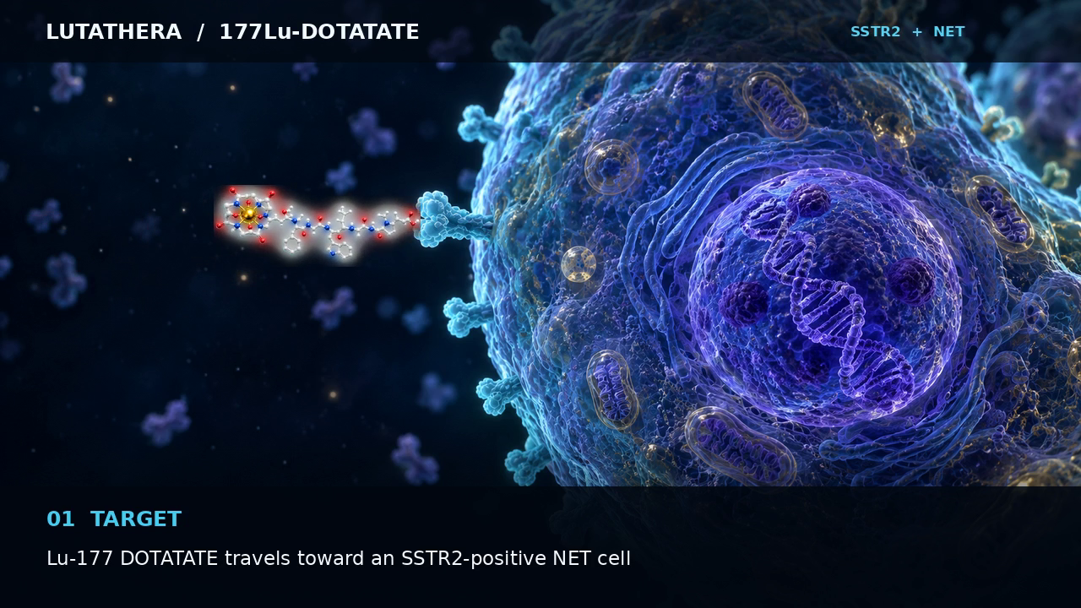
HOW LUTATHERA TARGETS NET CELLS
¹⁷⁷Lu-DOTATATE • SSTR2 binding • cellular uptake • β radiation

Slide 10
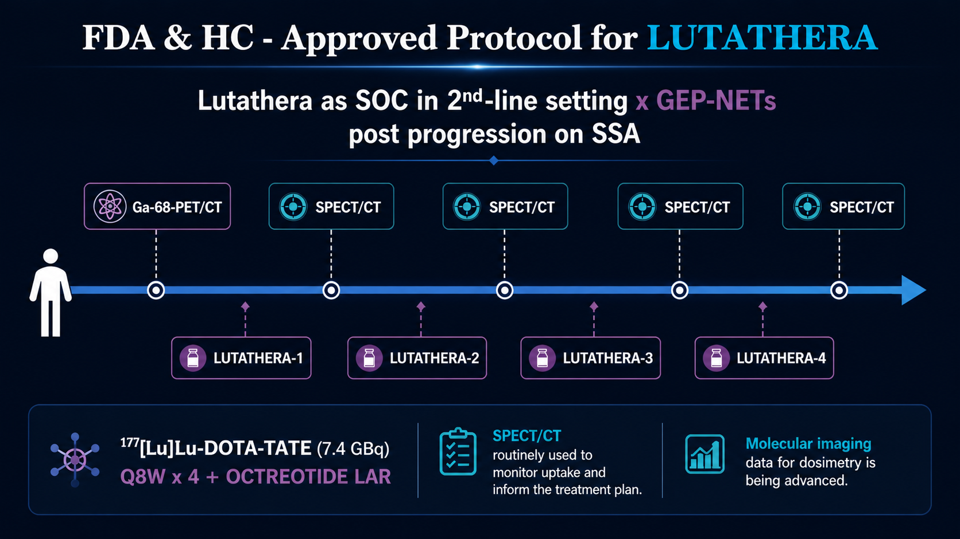

Slide 11
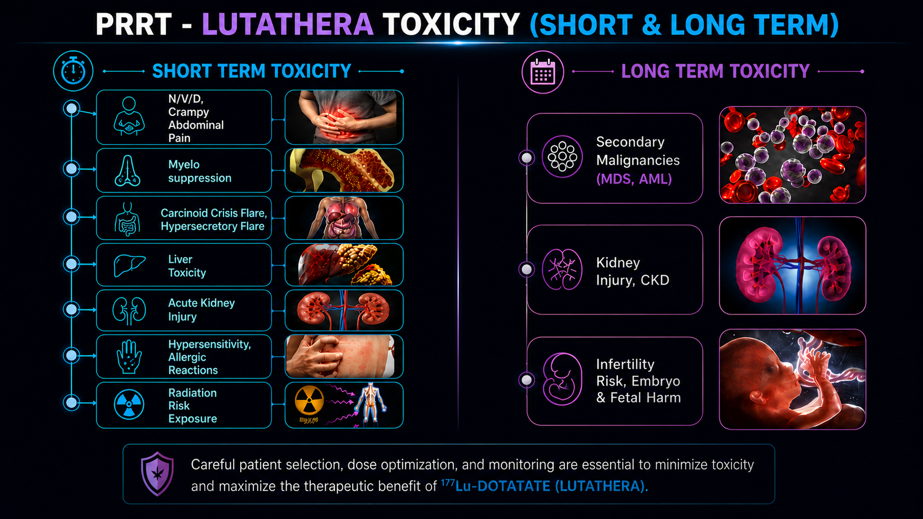

Slide 12
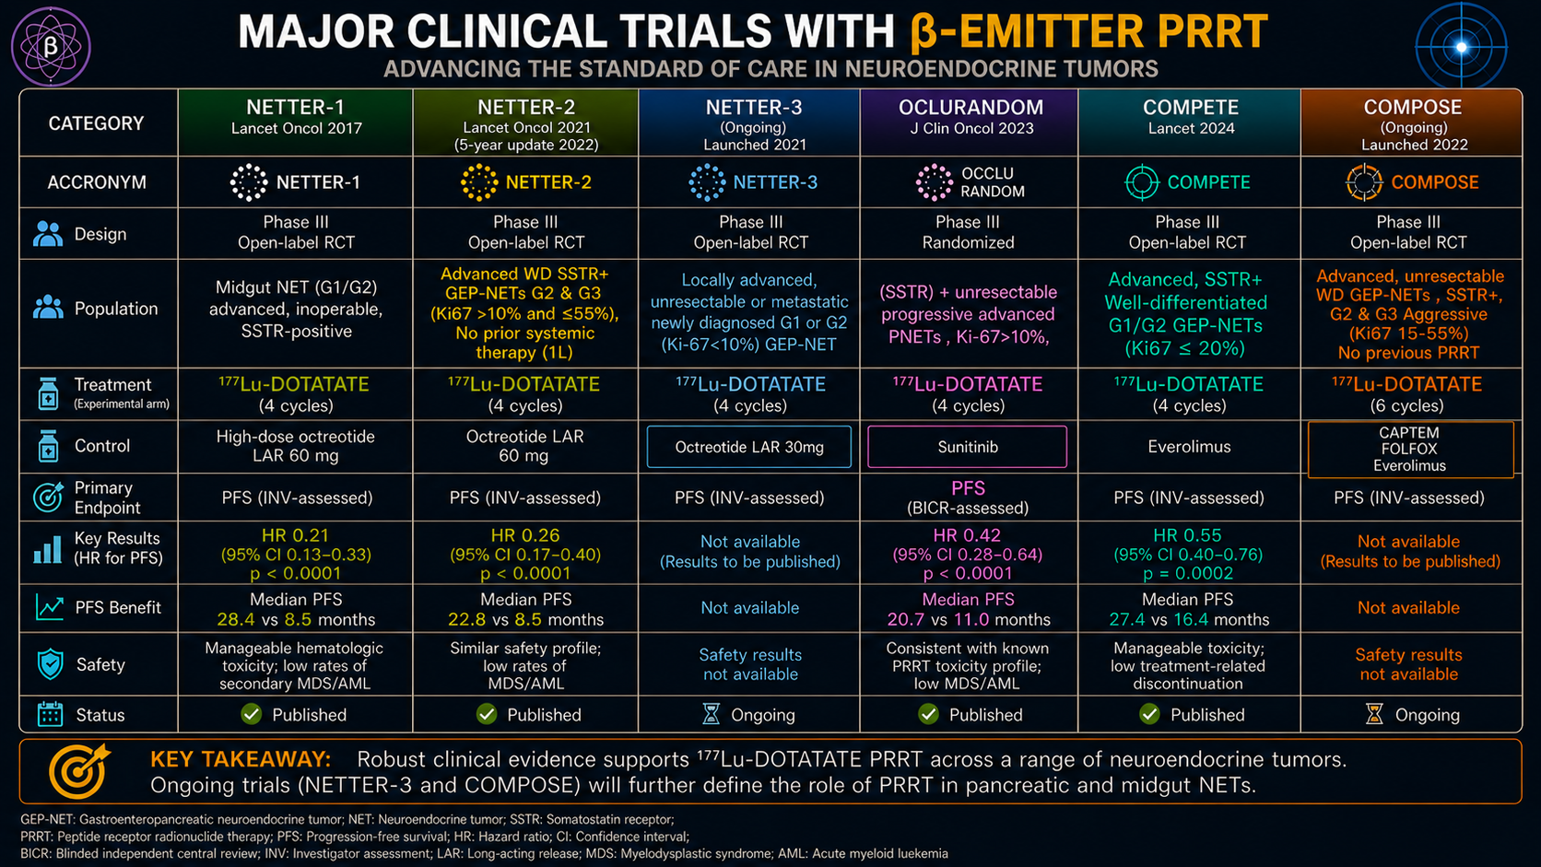

Slide 13
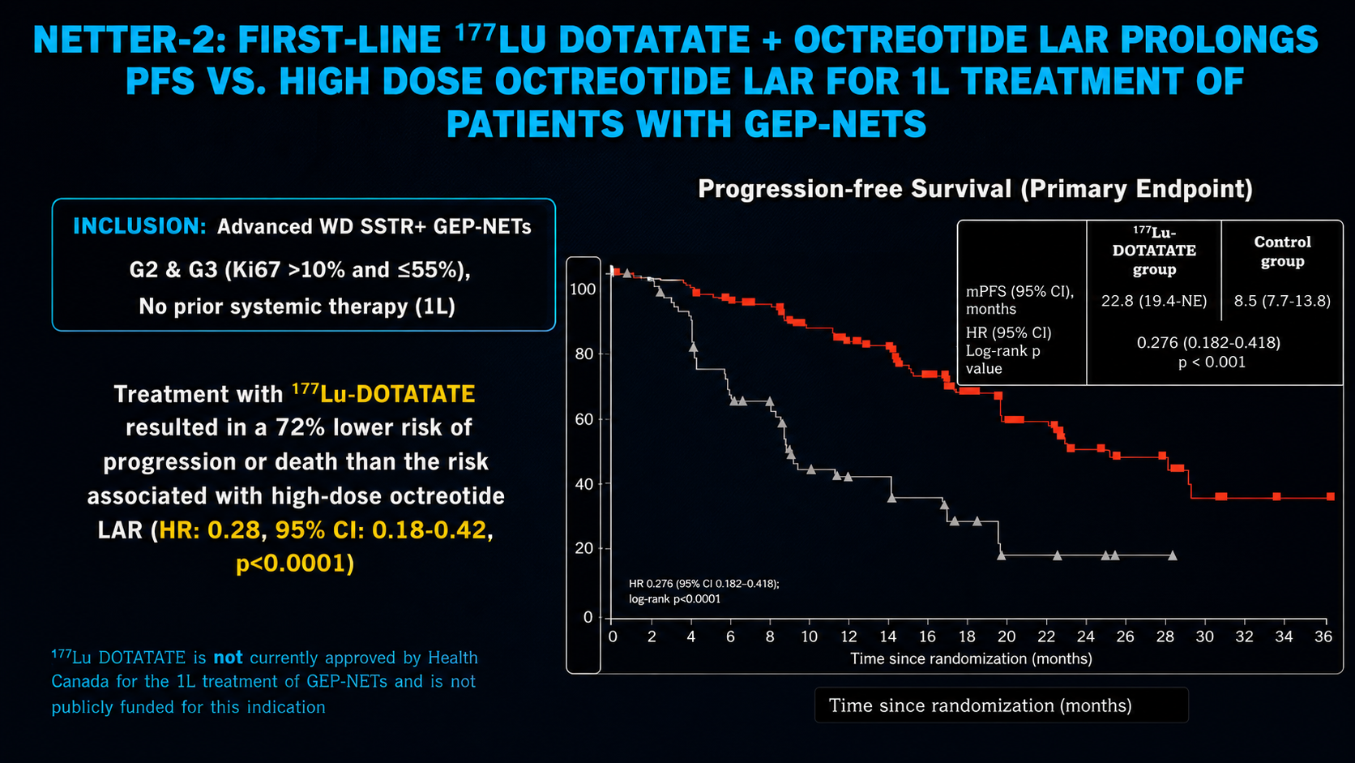

Slide 14
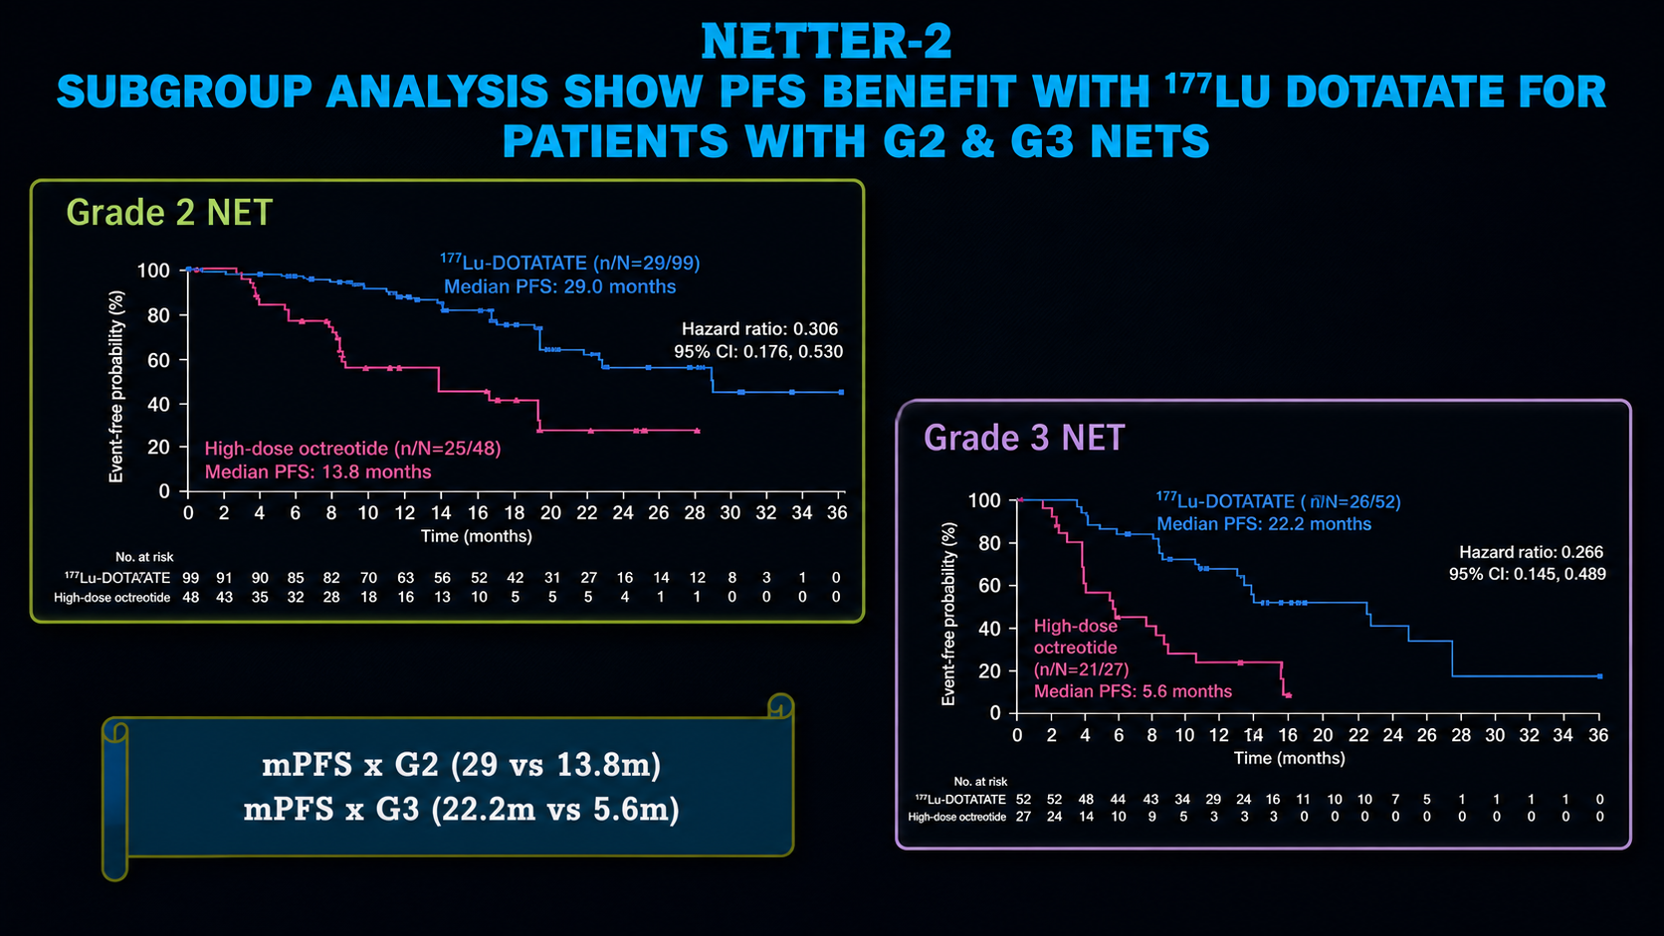

Slide 15
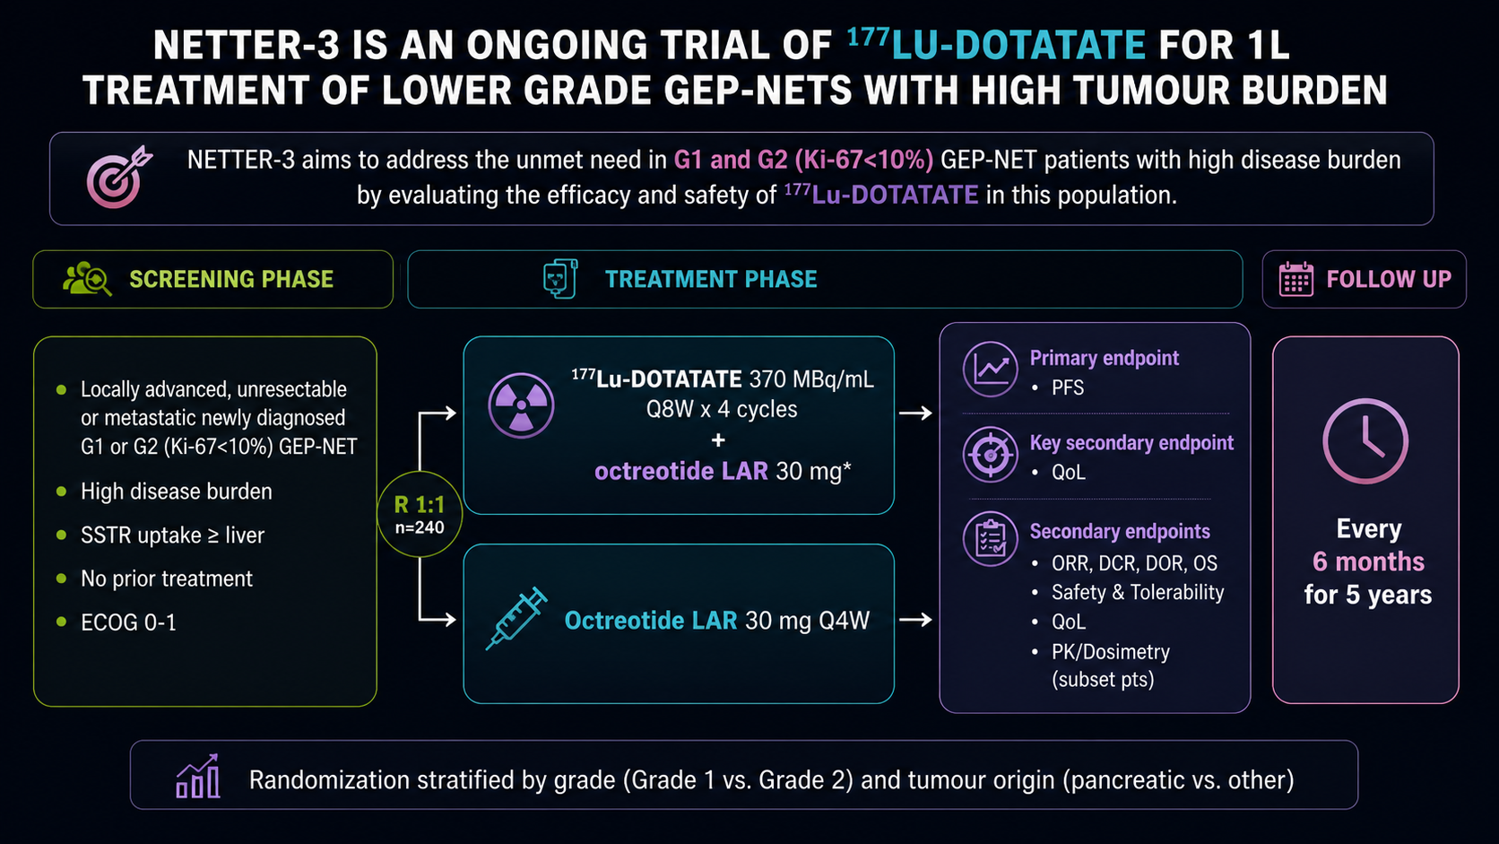

Slide 16
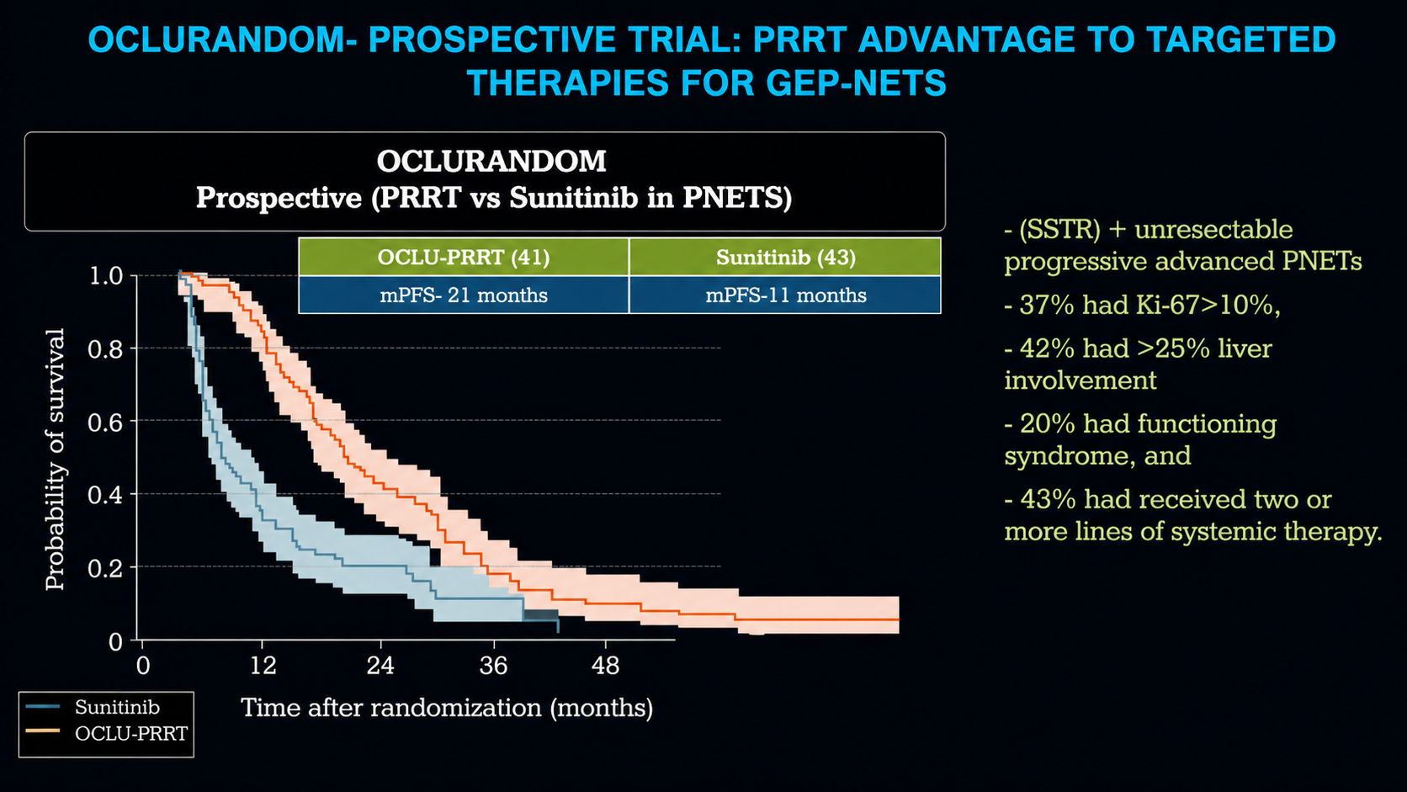

Slide 17
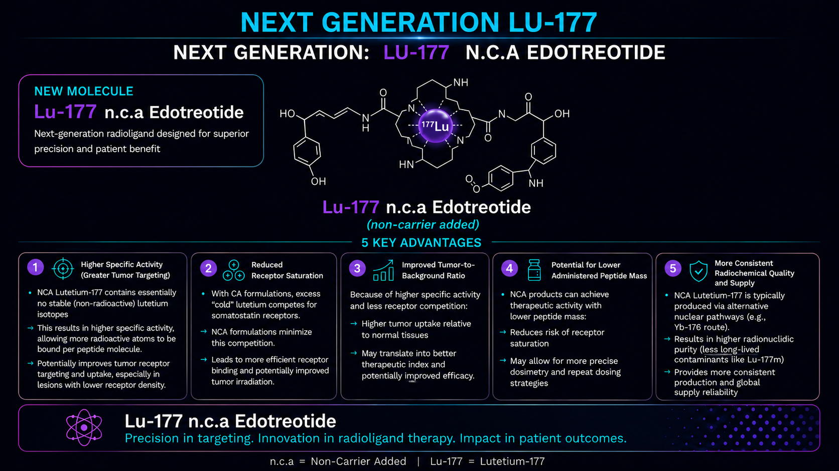

Slide 18
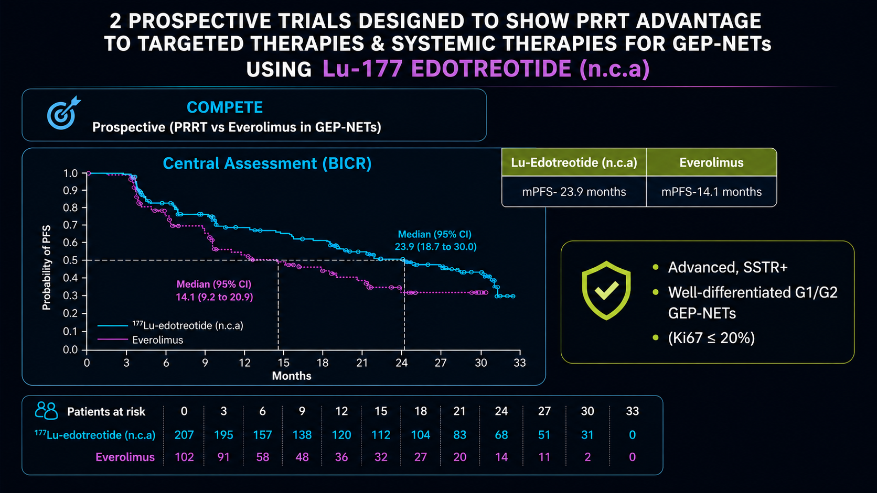

Slide 19
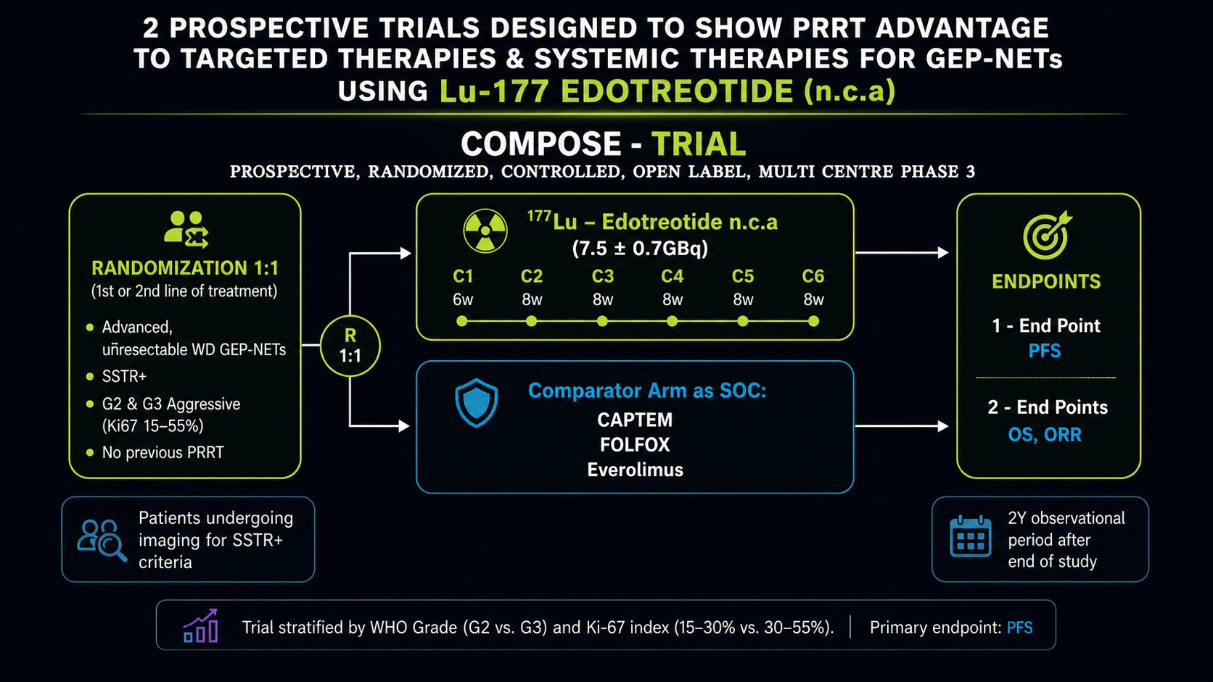

Slide 20

ESMO Clinical Practice Guidelines
Impact of new data on treatment algorithm
GEP-NENs
SI-NETs
Pan-NETs
NEC G3
NET G1/G2 SSTR-positive
Ki-67 <10% or slow growth
NET G2
Ki-67 >10–15% or rapid growth
SSTR-negative
NET G1
stable disease or slow growth
NET G2
NET G3
Ki-67 <50%
SSTR-negative
Cisplatin or carboplatin + etoposide
NETTER-2
NETTER-2
Ki-67 <10%
Watch & wait
SSA
EVE
Loco-regional therapy
SSA
STZ/5-FU
CAPTEM
EVE
SUN
CAPTEM
STZ/5-FU
STZ/5-FU
CAPTEM
EVE
SUN
FOLFIRI
FOLFOX
CAPTEM
+/- locoregional therapy
STZ/5-FU
CAPTEM
EVE
SUN
PRRT
EVE
EVE SUN
PRRT
PRRT
COMPETE
FOLFOX
TEM+/-CAP
IFN-alpha
PRRT
EVE
PRRT
EVE; SUN
CABINET
CABINET
Ann Oncol. 2020;31:844–60

Slide 21








α
MAJOR CLINICAL TRIALS WITH
α-EMITTER PRRT
THE EMERGING CLINICAL LANDSCAPE IN SOMATOSTATIN-RECEPTOR–POSITIVE NEUROENDOCRINE TUMOURS
CATEGORY
ALPHAMEDIX02
VMT-α-NET
ACTION-1
Ac-225 DOTATATE IITs
NCT05153772
NCT05636618
NCT05477576
NCT06166498 • NCT06732505
Design
Phase II
Multicentre, open-label; 2 cohorts
Phase I/IIa
Dose finding and expansion
Phase Ib/III
Randomized, open-label
Early-phase investigator studies
Dose escalation / feasibility
Population
SSTR+ unresectable or metastatic NET
PRRT-naïve and prior-PRRT cohorts
Advanced SSTR2+ NETs
Expansion includes GEP-NETs; prior PRRT permitted by cohort
Inoperable, well-differentiated G1–2 GEP-NET
Progression after ¹⁷⁷Lu-SSA PRRT
Progressive, unresectable or metastatic SSTR+ NETs
Eligibility and prior PRRT vary by protocol
Treatment
²¹²Pb-DOTAMTATE
67.6 μCi/kg × 4 cycles
²¹²Pb-VMT-α-NET
Image-guided Pb-203/Pb-212 theranostic platform
²²⁵Ac-DOTATATE (RYZ101)
10.2 MBq × 4; every 8 weeks
²²⁵Ac-DOTATATE
Protocol-specific activity and cycle number
Comparator
None
Single-arm cohorts
None
Single-arm dose finding
Investigator’s choice
everolimus, sunitinib or SSA
None
Single-arm studies
Primary endpoint
ORR by RECIST 1.1
Safety, PFS, OS and duration of response
Optimal biologic / recommended dose
Safety; ORR in expansion
Phase III: PFS by blinded central review
Phase Ib: safety and dose selection
DLTs and recommended dose
Safety with preliminary response assessment
Early efficacy
Met prespecified efficacy threshold
PRRT-exposed cohort: ORR 34.6%, DCR 96.2%*
Antitumour activity reported in dose-finding cohorts
Mature PFS data pending
Phase Ib confirmed ORR ≈29%
Phase III efficacy not yet reported
No comparative efficacy results
Prospective validation pending
Key safety focus
Marrow and renal toxicity
Dysphagia: 48.6%
Long-term hematologic follow-up
Renal uptake and marrow exposure
Dose-limiting toxicity window
Renal, marrow and hepatic exposure
Cumulative post-¹⁷⁷Lu toxicity
Renal and marrow dosimetry
Late toxicity and isotope availability
Status
Active, not recruiting
Phase II results reported
Active Phase I/IIa
Expansion program ongoing
Phase III ongoing
Global registration study
Early phase
Recruitment/status varies by study
◎
KEY TAKEAWAY:
Alpha-PRRT has moved from rescue series into prospective multicentre development. Pb-212 programs now show encouraging Phase II / dose-expansion activity, while ACTION-1 is testing Ac-225 after Lu-177 PRRT in a randomized Phase III trial.
*Preliminary reported data; cross-trial comparisons are inappropriate. Trial status checked September 2026. Abbreviations: DCR, disease control rate; DLT, dose-limiting toxicity; GEP-NET, gastroenteropancreatic neuroendocrine tumour; IIT, investigator-initiated trial; ORR, objective response rate; PRRT, peptide receptor radionuclide therapy; SSA, somatostatin analogue; SSTR, somatostatin receptor.

Slide 22
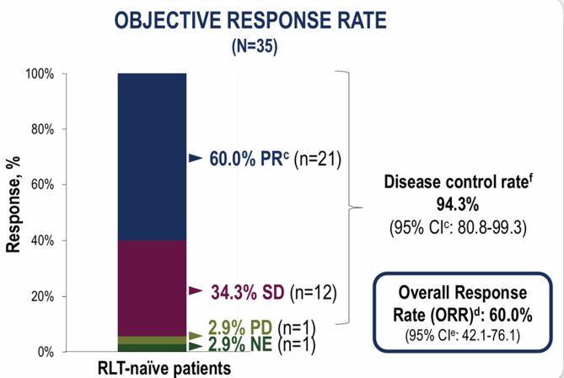
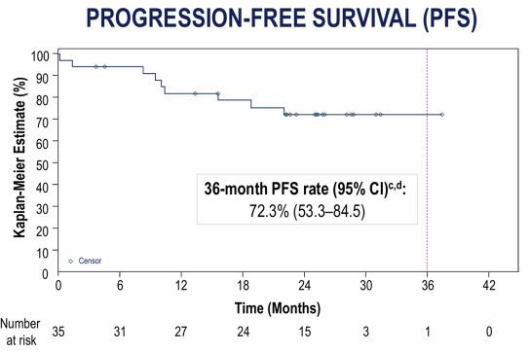
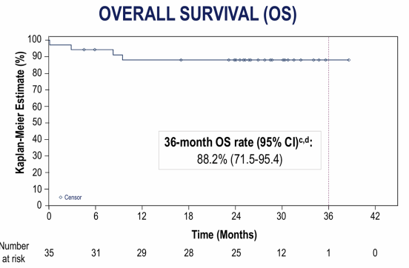
ALPHAMEDIX-02: PHASE 2 STUDY DESIGN AND RESULTS
STUDY DESIGN
²¹²Pb-DOTAMTATE
Open-label, multicentre; unresectable or metastatic SSTR+ GEP-NETs
67.6 μCi/kg every 8 weeks
Cohort 1: RLT-naïve (N=35) • Cohort 2: RLT-exposed (N=26)
Up to 4 doses
COHORT 1: OBJECTIVE RESPONSE
PROGRESSION-FREE SURVIVAL
OVERALL SURVIVAL
INVESTIGATOR-ASSESSED RESPONSE
36-MONTH PFS
36-MONTH OS
ORR 60.0% • DCR 94.3%
72.3%
88.2%
DoR ≥24 mo: 71.9% of responders
95% CI 53.3–84.5
95% CI 71.5–95.4
BICR: ORR 57.1% • DCR 85.7% • 36-month PFS 63.3% (95% CI 40.3–79.4)
Cohort 1 outcomes shown. BICR = blinded independent central review; DoR = duration of response.

Slide 23
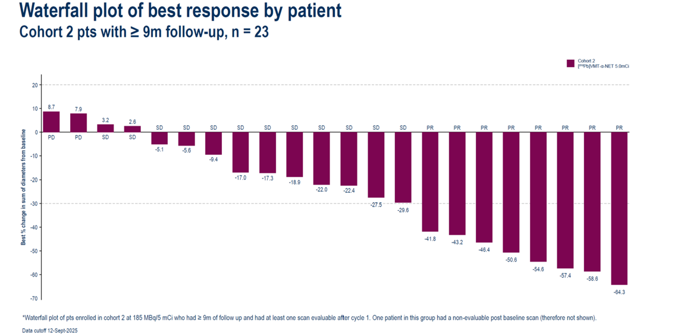
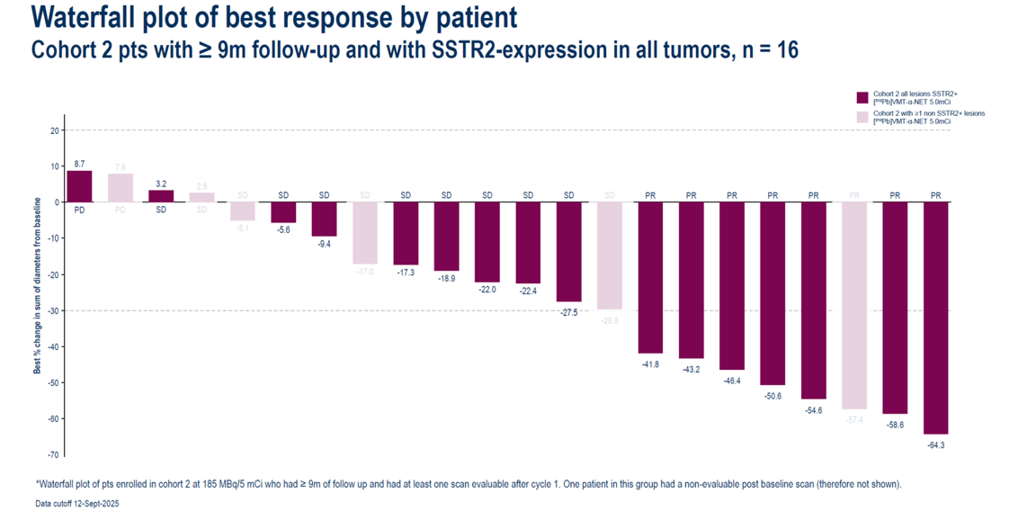
²¹²Pb-VMT-α-NET STUDY: DESIGN, EXPOSURE AND RESPONSE
STUDY DESIGN
EXPOSURE AND FOLLOW-UP
BOIN-12 dose finding → RP2D expansion
55 treated • 30 (55%) received 4 doses • median follow-up 28 wk
Population: progressive, advanced/unresectable or metastatic NETs; PRRT-naïve; SSTR2 PET/CT–avid disease in ≥1 lesion
C1
C2 ≥9mo
C2 <9mo
C3
All
n
2
23
23
7
55
C1 2.5 mCi ×4 (n=2) • C2 5 mCi ×4 (n=7; 46 including added slots) • C3 6 mCi ×4 (n=8; opened June 2025)
1 dose
—
3 (13%)
2 (9%)
7 (100%)
12 (22%)
2 doses
—
—
3 (13%)
—
3 (6%)
Optional C4: up to 8 patients, dose TBD; intermediate or de-escalated doses possible. FDA interaction precedes the next cohort.
3 doses
—
—
10 (44%)
—
10 (18%)
4 doses
2 (100%)
20 (87%)
8 (35%)
—
30 (55%)
Expansion: RP2D ×4 in GEP-NETs, bronchial NETs and pheo/paraganglioma.
Med f/u
96
41
22
4
28
Primary: safety/tolerability, RP2D, ORR, dosimetry • Secondary: ORR, BOR, DoR, PFS, OS, PK • ²⁰³Pb dosimetry
Doses shown as n (%); median follow-up in weeks. Data cutoff: 12 Sep 2025.
COHORT 2: BEST CHANGE FROM BASELINE (≥9 MONTHS, n=23)
SSTR2-EXPRESSING IN ALL TUMOURS (n=16)
Cohort 2 waterfall plots show individual patient response; one patient lacked an evaluable post-baseline scan. 5 mCi ×4 was used in the plotted cohort.

Slide 24
ACTION-1: PHASE Ib/III TRIAL
NCT05477576 • global, open-label • Phase III target n=210, randomized 1:1
ELIGIBILITY
Inoperable, well-differentiated G1–2, SSTR+ GEP-NET
Progression after 2–4 cycles of ¹⁷⁷Lu-SSA PRRT; ECOG 0–2
Adequate hematologic and renal function; prior ¹⁷⁷Lu disease control ≥3 months
PHASE III RANDOMIZED TREATMENT
²²⁵Ac-DOTATATE (RYZ101)
INVESTIGATOR’S CHOICE
10.2 MBq (275 µCi) ×4
Everolimus, sunitinib or high-dose long-acting SSA
Every 8 weeks
Crossover to RYZ101 permitted after progression
PHASE III PRIMARY ENDPOINT
PHASE Ib
PFS by blinded central review
Safety, PK and dose selection
PHASE Ib RESULTS (N=17)
PHASE III STATUS
Confirmed ORR 29.4% (5/17)
Recruiting; efficacy results pending
35.3% (6/17) including a response confirmed after cutoff
BMS projects registrational data in 2027
Phase Ib safety: no DLTs or treatment-related SAEs; grade ≥3 TEAEs in 9/17 (52.9%)
Phase Ib response and safety data are single-arm; they do not establish a Phase III comparative benefit.
Notes:
.

Slide 25
LUTATHERA COMBINATION TRIALS
INVESTIGATIONAL PARTNERS AND DRUG CLASSES
IDENTIFIER
PHASE
CONDITION
REGIMEN
PARTNER DRUG CLASS
NCT05178693
I
NEN
Lutathera + ASTX727
DNA hypomethylating agent
NCT05724108
II
Metastatic NENs
Lutathera + Triapine
Ribonucleotide reductase inhibitor (DNA synthesis/repair)
NCT04750954
I
NEN
Lutathera + Peposertib
DNA-dependent protein kinase inhibitor (DNA repair)
NCT02358356
II
GEP-NEN
Lutathera + Capecitabine + Temozolomide
Antimetabolite; alkylating agent
2014-003067-38*
II
GEP-NEN
Lutathera + Capecitabine
Antimetabolite
NCT05053854
I
Metastatic GEP-NEN
Lutathera + Talazoparib
PARP inhibitor
NCT04375267
I
NEN; SSTR2+ thymoma or mesothelioma
Lutathera + Olaparib
PARP inhibitor
NCT05870423
I
NEN
Lutathera + Olaparib
PARP inhibitor
NCT04086485
I/II
GEP-NEN
Lutathera + Olaparib
PARP inhibitor
NCT05687123
I
Pancreatic NEN
Lutathera + Sunitinib
Tyrosine kinase inhibitor
NCT05249114
I
NEN
Lutathera + Cabozantinib
Tyrosine kinase inhibitor
NCT03629847
I/II
GEP- and lung NEN
Lutathera + Everolimus
mTOR inhibitor
NCT06663072
I
Pancreatic NEN
Lutathera + Fulvestrant
ER antagonist
NEN = neuroendocrine neoplasm; GEP = gastroenteropancreatic; SSTR2 = somatostatin receptor 2. * Identifier reproduced from the source slide.

Slide 26
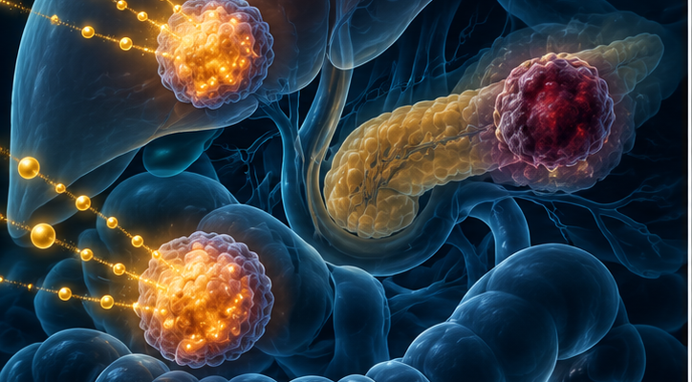
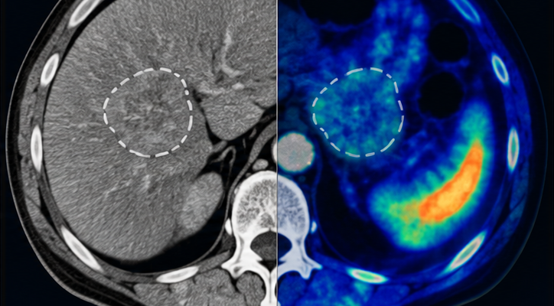
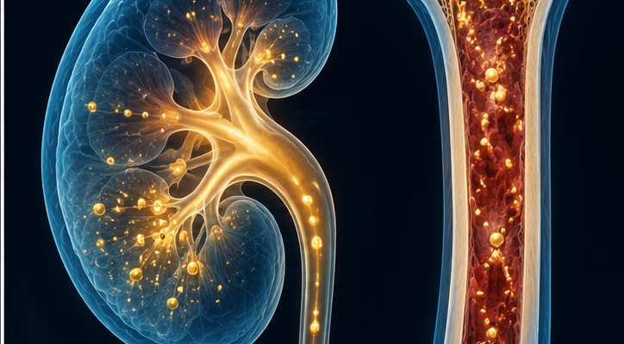
GAPS AND PITFALLS OF PRRT IN GEP-NETs
TARGETING • RESPONSE ASSESSMENT • LONG-TERM SAFETY
RESISTANCE & HETEROGENEITY
RESPONSE ASSESSMENT
ORGAN AND LATE TOXICITY
Primary or acquired resistance limits durable control.
Anatomic shrinkage may lag clinical or molecular benefit.²
Marrow and kidney exposure constrain repeat treatment.³
SSTR-low / FDG-avid lesions may escape SSTR-targeted radiation.¹
RECIST alone can misclassify equivocal or delayed response.²
NETTER-1: MDS occurred in 2/111 (2%) treated patients.⁴
Dual-tracer PET can reveal biologically discordant disease.¹
Use consistent CT/MRI; add SSTR PET for unclear lesions.²
Renal protection and long-term blood/renal monitoring matter.³
PRACTICAL GAP
Match treatment to every lesion, interpret response across modalities, and preserve organ reserve for later lines.
¹ NETPET 2017 ² ENETS Task Force 2025 ³ NANETS/SNMMI procedure standard ⁴ NETTER-1 final safety 2021. Illustrations are conceptual.

Slide 27
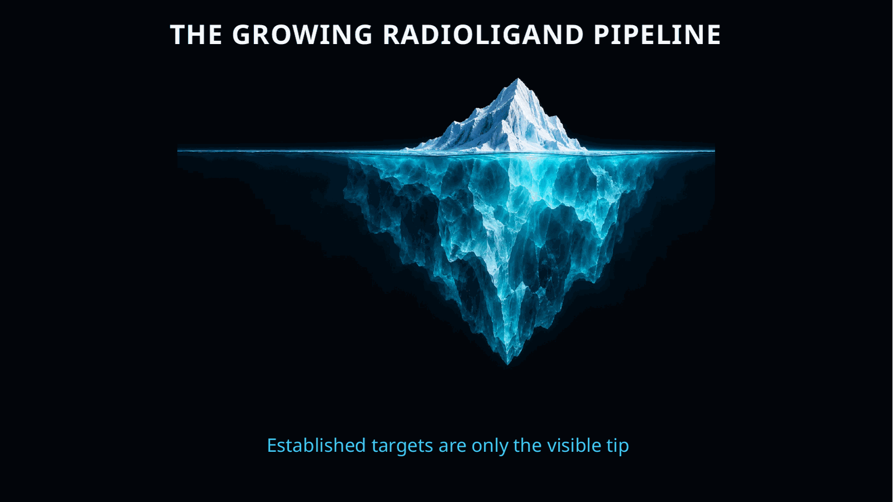

Slide 28


THANK YOU
Dr Alda Aleksi

