Slide 1


The WHO Classification of Neuroendocrine Neoplasms
Sylvia L. Asa, MD, PhD
Consultant in Endocrine Pathology, University Hospitals Cleveland Medical Center
Professor of Pathology, Case Western Reserve University

Slide 2
What Are Endocrine Cells?
Endocrine cells are cells that make hormones
Three kinds of endocrine cells for three families of hormones:
  Neuroendocrine cells make peptide hormones
  Thyroid follicular cells make thyroid hormones
  Steroid cells make steroid hormones

Slide 3
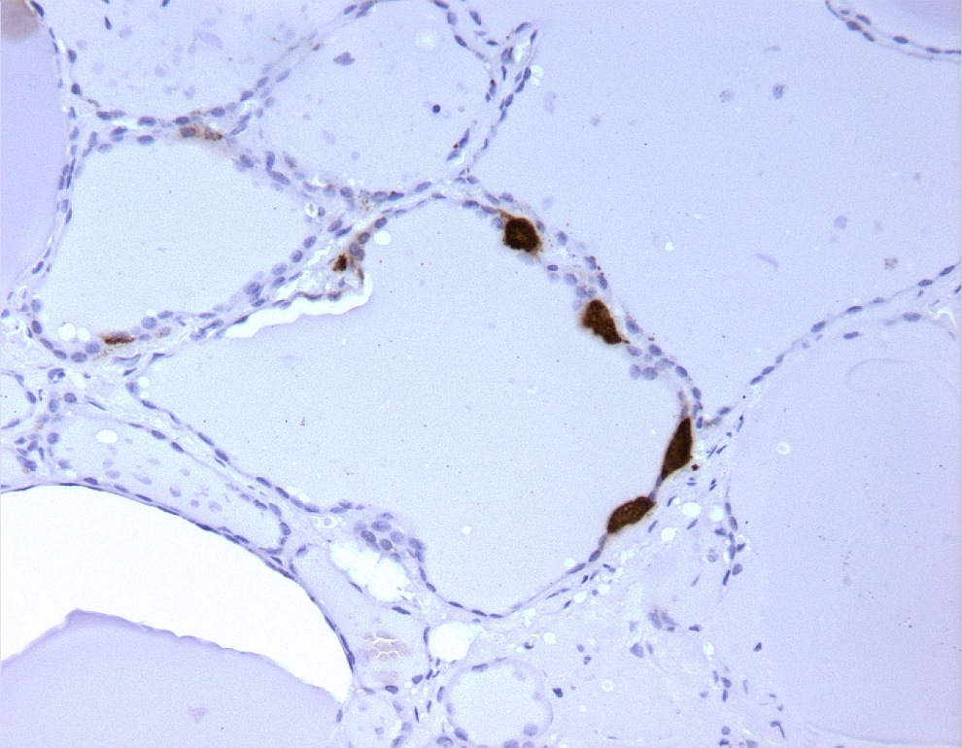
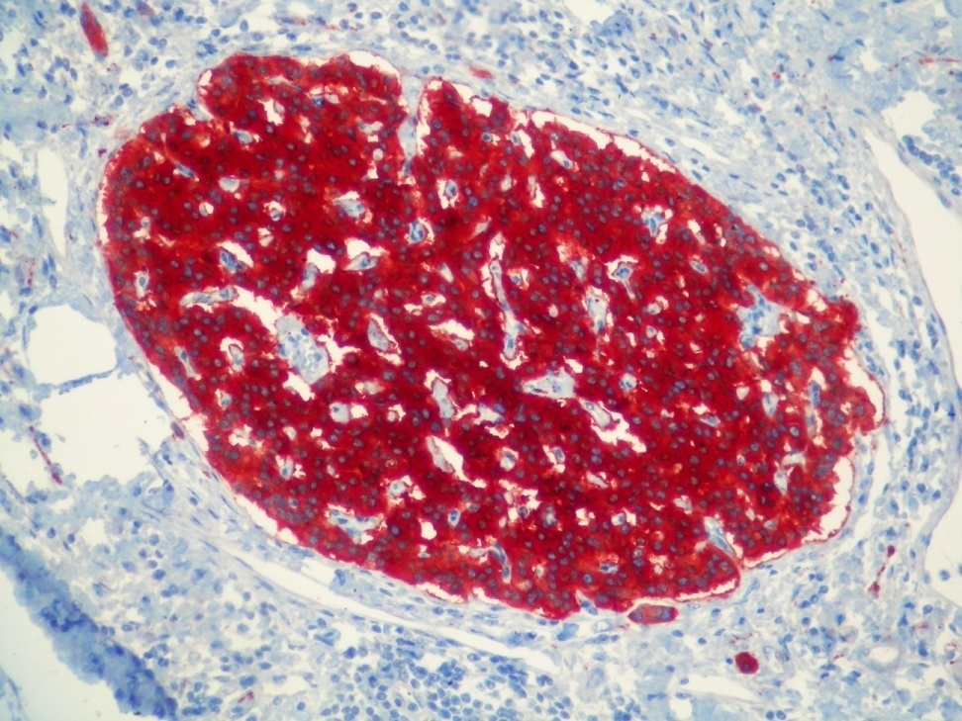
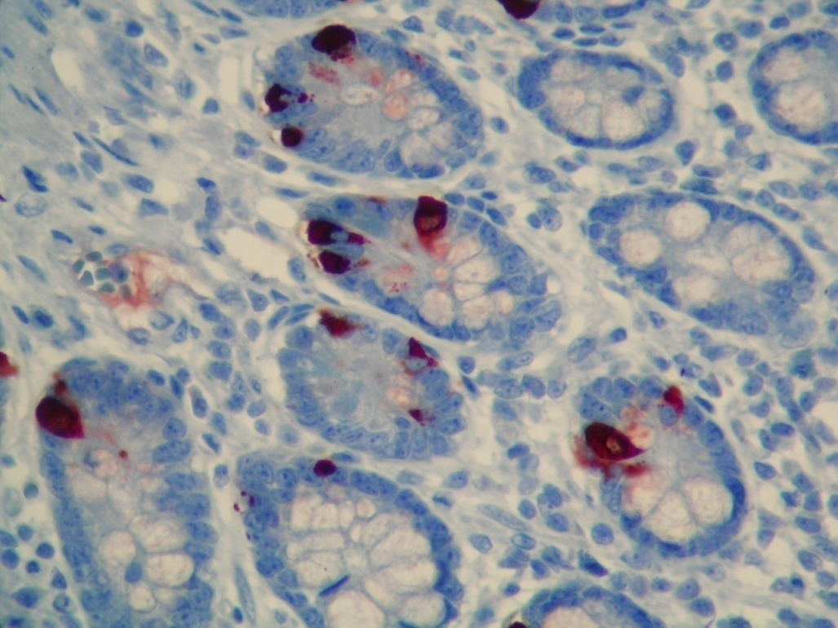
Neuroendocrine Cells
Calcitonin
Bombesin
Serotonin
Insulin/Glucagon/Somatostatin/PP

Slide 4
Sites of Neuroendocrine Cells and Neoplasms
Epithelial
Pituitary
Thyroid
Parathyroid
Thymus
Lung
Pancreas
Gut
GU tract
Prostate
Gonads
Non-Epithelial (PPGL)
Asa et al, J Clin Med, 2018Sep 13;7(9). pii: E280. doi: 10.3390/jcm7090280

Slide 5
What Are Neuroendocrine Neoplasms?
A Common Classification Framework
for Neuroendocrine Neoplasms:
An IARC – WHO expert consensus proposal
Rindi et al Modern Pathol, 2018
NENs arise at almost any anatomical site and are distributed throughout the body in organs of all types, as well as in soft tissues;
NENs at various sites are of epithelial or neuronal/neuroectodermal origin, and share morphological and protein expression signatures depending on differentiation;
NENs express a variable spectrum of proteins, shared with normal NE cells at specific anatomical locations, including markers of neuroendocrine differentiation (such as INSM1, chromogranins and synaptophysin) as well as site-specific markers such as hormones and transcription factors.

Slide 6
Classification of Neuroendocrine Neoplasms
A Common Classification Framework
for Neuroendocrine Neoplasms
An IARC – WHO expert consensus proposal
Rindi et al Modern Pathol, 2018
Neuroendocrine neoplasm (NEN) encompasses all tumor classes with predominant neuroendocrine differentiation, including non-epithelial and both well and poorly differentiated epithelial forms;
The well differentiated family is designated “neuroendocrine tumor (NET)”, and the poorly differentiated family “neuroendocrine carcinoma (NEC); paragangliomas (i.e. NEN of non-epithelial origin) are regarded as a third family of NENs;
Well-differentiated neoplasms (NETs) are usually be graded in three tiers as G1, G2 and G3, corresponding to low-, intermediate-, and high-grade.

Slide 7
Well-differentiated vs Poorly-differentiated
Epithelial Neuroendocrine Neoplasms
Some common histologic, immunophenotypic & ultrastructural features
BUT
Different degrees of biological aggressiveness
Different responses to medical therapy
Different risk factors and hereditary predispositions
Different relationships to non-neuroendocrine neoplasia
Different genetic alterations
  Pancreas: MEN1, DAXX/ATRX, SETD2, VHL pathway vs TP53,RB1, KRAS, SMAD4
  Small and large bowel: CDNK1B vs TP53, RB1, APC
  Lung: MEN1, PSIP1ARID1A vs TP53, RB1, KRAS, STK11/KEAP1

Slide 8
What is Unusual About NETs?
Indolent but not benign
Hormone activity as well as tumor growth
Specific targeted therapies
High incidence of familial predisposition and multifocal disease

Slide 9
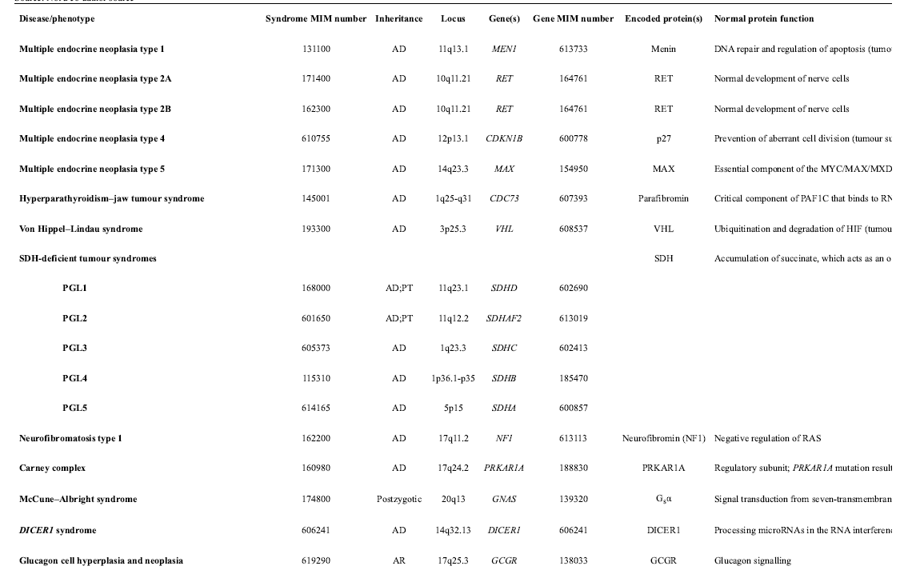
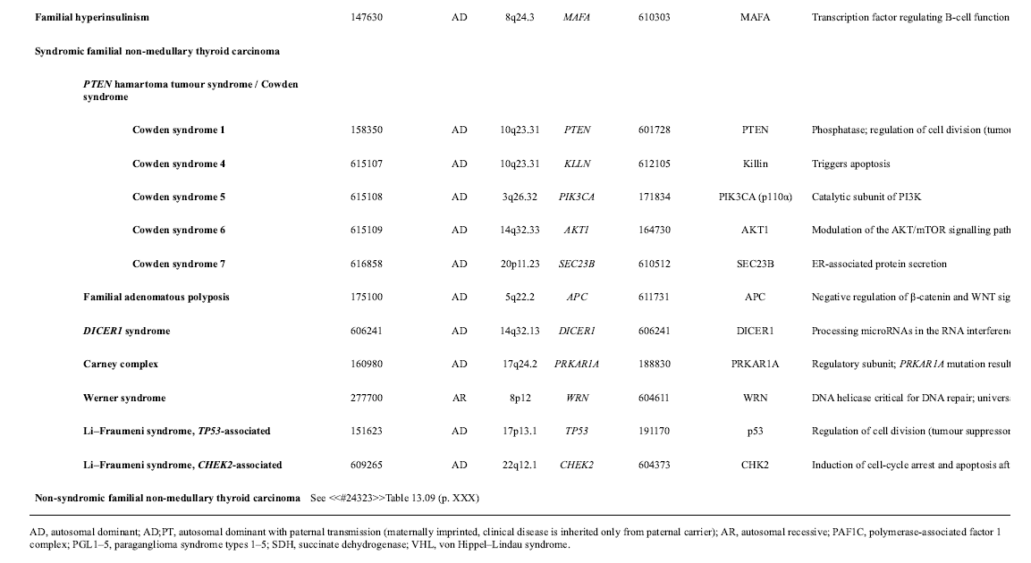
Genetic Syndromes with Neuroendocrine Tumors

Slide 10
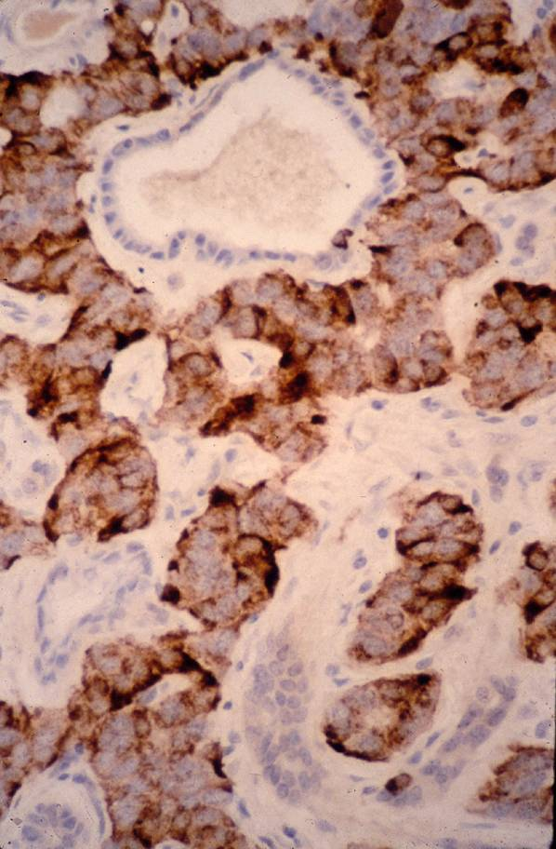
The Role of The Pathologist in the Diagnosis of NETs
Diagnose
  Confirm neuroendocrine differentiation
  Confirm epithelial differentiation or not
  Determine cellular origin and function
  Identify biomarkers for surveillance
2. Prognosticate
  Determine the proliferative rate (grade)
  Stage
3. Predict
  SSTRs
4. Genetic alterations and familial predisposition
  Molecular immunohistochemistry
  Precursor lesions
Diagnose
  Confirm neuroendocrine differentiation
2. Prognosticate
  Determine the proliferative rate (grade)
  Stage

Slide 11
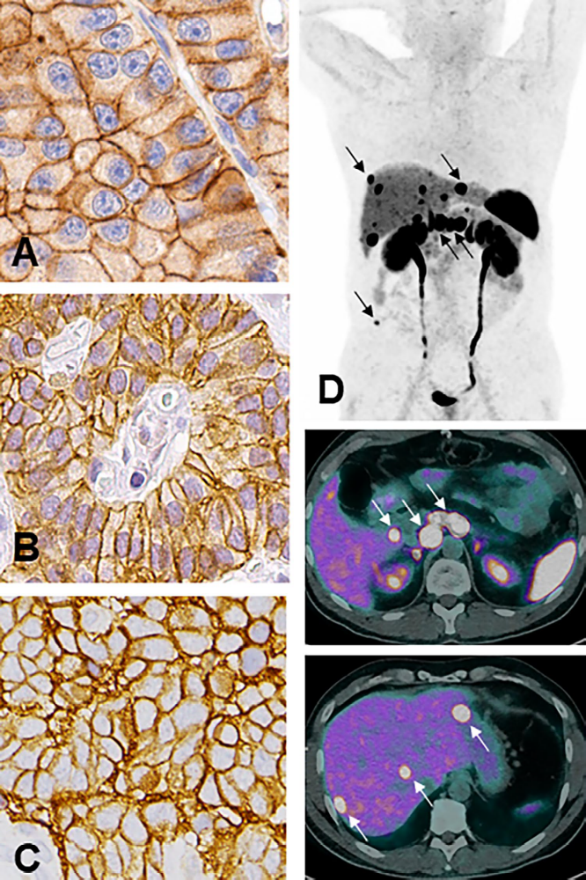
Well Differentiated
NET
Cells resemble normal NE cells
usually indolent
INSM1, synaptophysin, and chromogranin (usually); SSTR2 and/or SSTR5
Often hormone positive
Ki67: G1 vs G2 vs G3
May have loss of ATRX, menin
Wild-type p53 & Rb
SSTR2
SSTR5
Rindi et al, Endocr Pathol, 2022

Slide 12
Poorly Differentiated
NEC
High grade by definition; clinically aggressive with rapid progression
Usually subclassified as small cell or large cell subtypes
INSM1, synaptophysin positive; may have weak/focal chromogranin; usually negative for SSTRs and hormones
Ki67 usually >80%
Loss of Rb, mutant p53
Synapto
CGA
INSM1
Ki67
Rindi et al, Endocr Pathol, 2022
p53
Rb

Slide 13
NEC: Not One Disease
Primary small or large cell carcinomas
Transformation of NET to NEC by accumulation of additional mutations
Emergence of neuroendocrine dedifferentiation by epigenetic dysregulation in aggressive non-NE carcinomas
  e.g. high grade treatment-resistant prostate carcinoma

Slide 14
Problems in Diagnosis
Missing neuroendocrine features
  Not called NET or NEC
Misclassification
  Limitations of Ki67
Missing/misinterpreting multifocal primary tumors

Slide 15
What Does All This Mean for the Patient?
Questions??

